Slide 1

ABOUT OLD SHORT STORIES
GIUFÀ
TELL ME HOW IT WAS IN YOUR TIME, GRANDFATHER

Slide 2

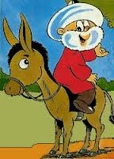
THE ORIGINS
Giufà, is a character of the Italian folklore. The anecdotes about his life have been retold and memorized through centuries of oral tradition. He is usually recognized as the "village fool", but, to tell the truth, his actions and words often provide a moral message.
So, his peers‘ reactions, rather than Giufà's outrageous behavior, are judged at the end of each story.
These features are visible in the folk characters of many Mediterranean cultures. In fact, it seems that this funny character comes from stories of Nasrudin Hedjia, a Turkish folk character. It is believed that during the Islamic rule, stories of this man were absorbed into the Sicilian oral tradition, transformed to exemplify cultural norms and eventually transmitted throughout southern Italy.

Slide 3
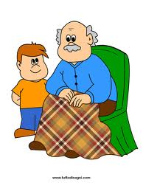
THE INVITATION
A grandfather has been invited to school to tell some funny stories about this funny character: pupils didn’t know Giufà and they enjoyed his anedoctes very much!

Slide 4
THE PRODUCTION
Our pupils have realized some pictures to represent two short stories:
Giufà and the hen;
Giufà takes away the door.

Slide 5
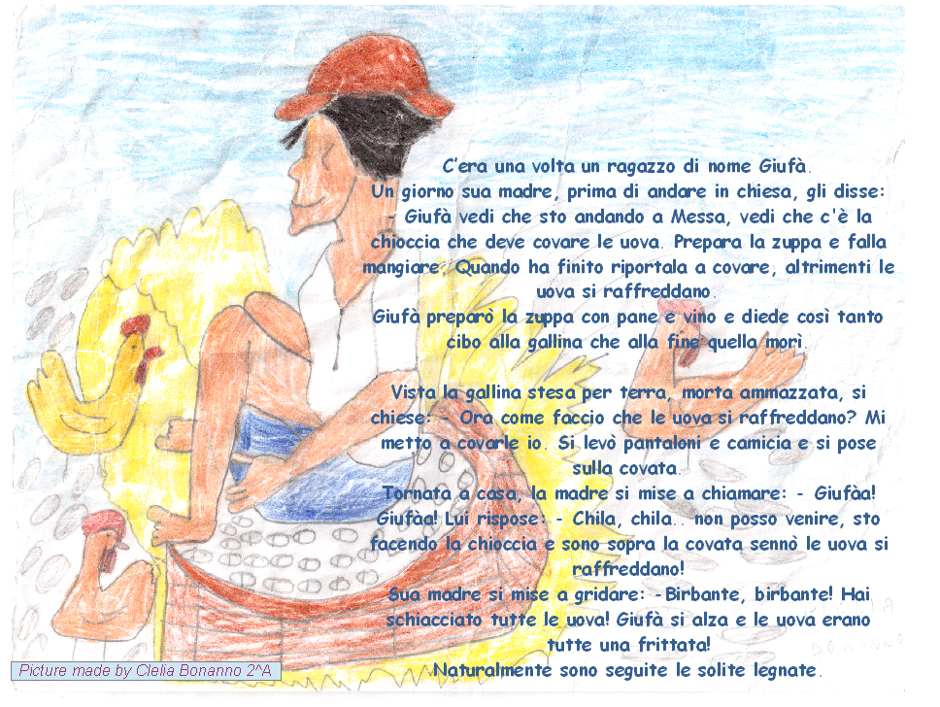
Giufà e la chioccia

Slide 6
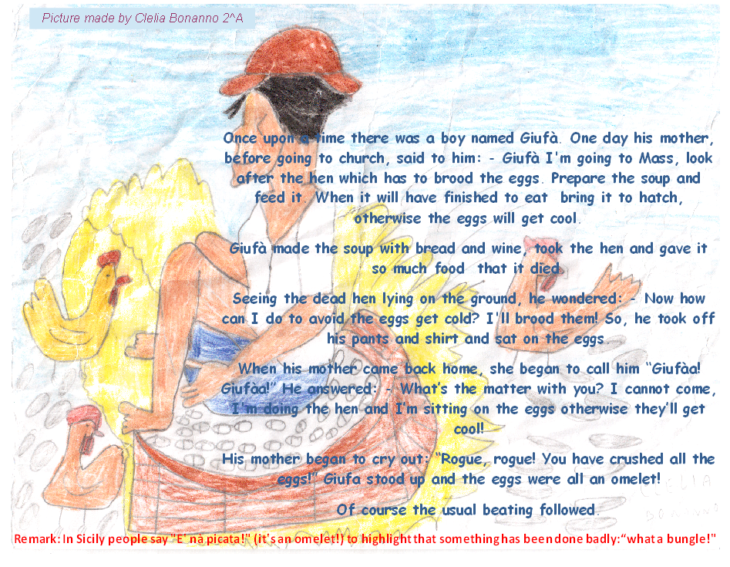
Giufà and the hen

Slide 7
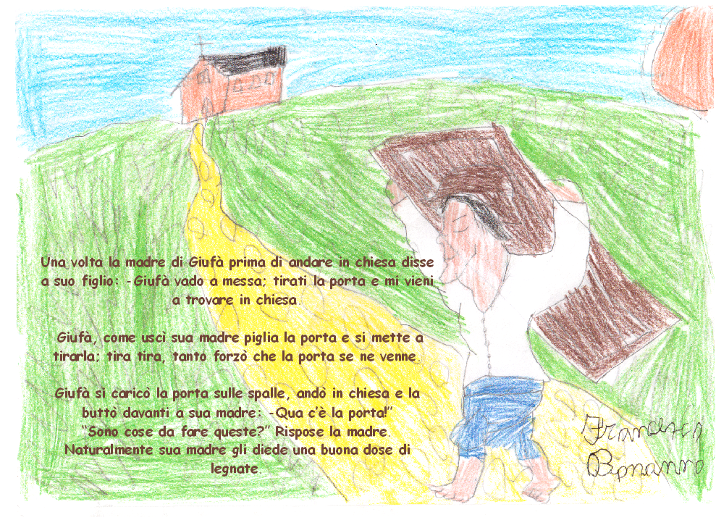
Giufà tira la porta

Slide 8
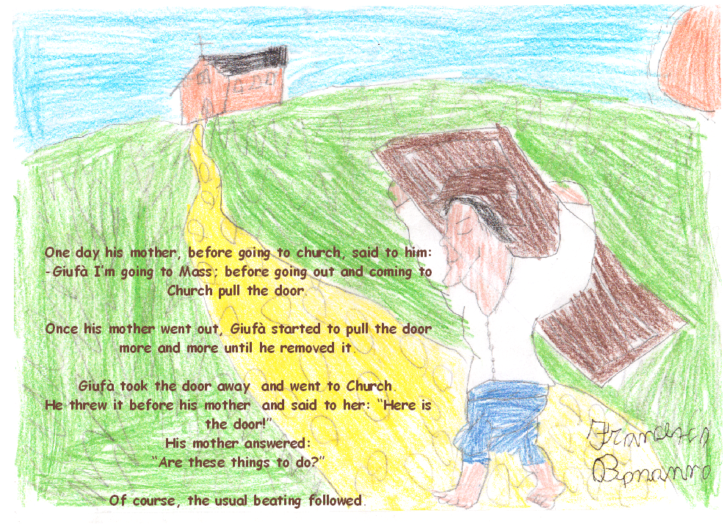
Giufà takes away the door

